Slide 1
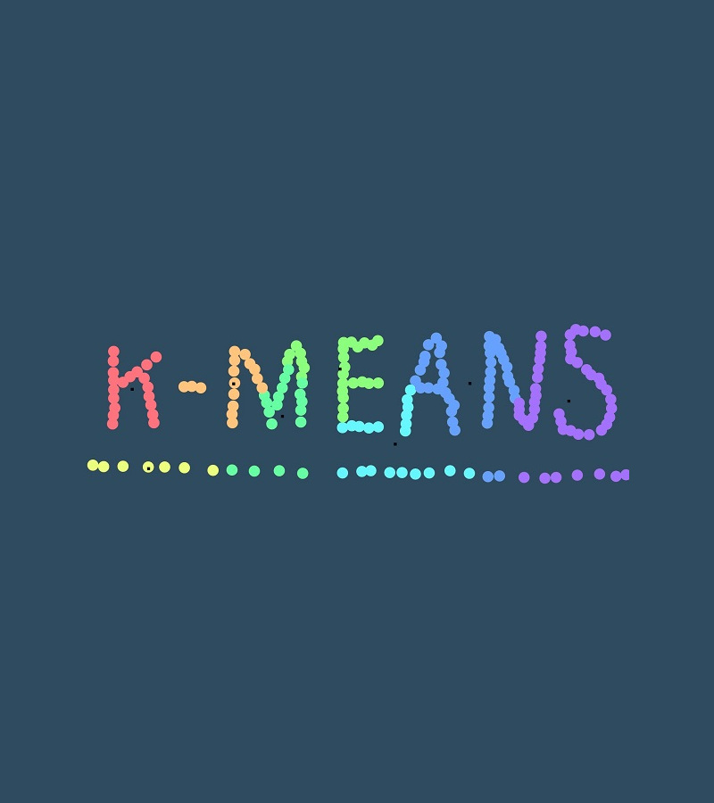
Introduction to K-Means Clustering
Yiwei YU
IoT CC, Shenzhen
2022 Oct

Slide 2
Agenda
#
K-Means
#
Practical Example
#
Unsupervised Learning
#
Q & A
#
Dissimilarity Metrics
#
K-Means Algorithms

Slide 3
After This Presentation You Will be able to
Describe the steps in the K-Means algorithm.
Explain what the “K” stands for K-Means.
Define what a cluster centroid is.
General approach to processing data using K-Means.

Slide 4
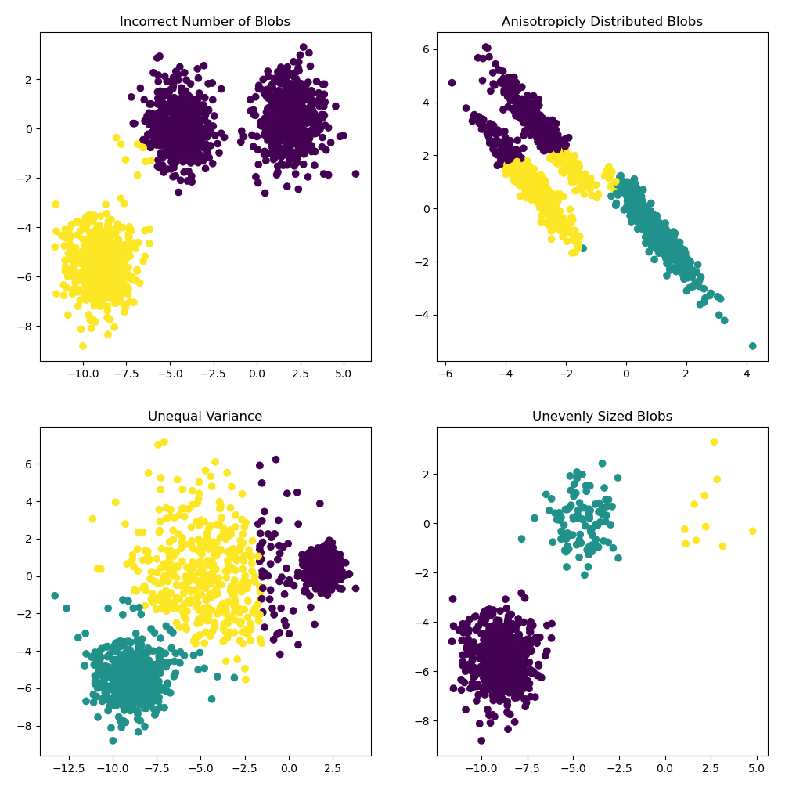
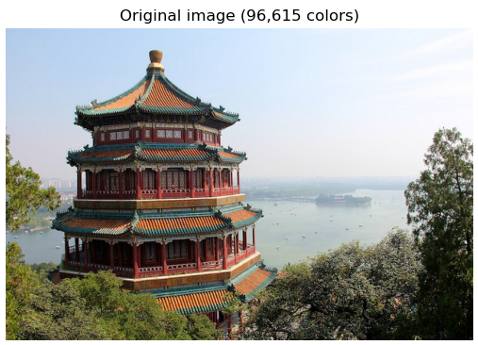
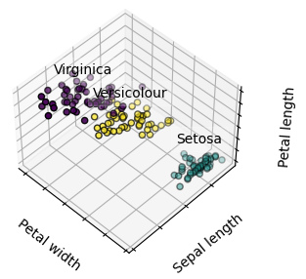

What is K-Means Clustering
K-Means is a type of partitioning clustering, that is, it divides the data into K non-overlapping subsets or clusters without any cluster internal structure or labels. This means, it's an unsupervised algorithm.
Compression
Example 1
Example 2
Example 3

Slide 5
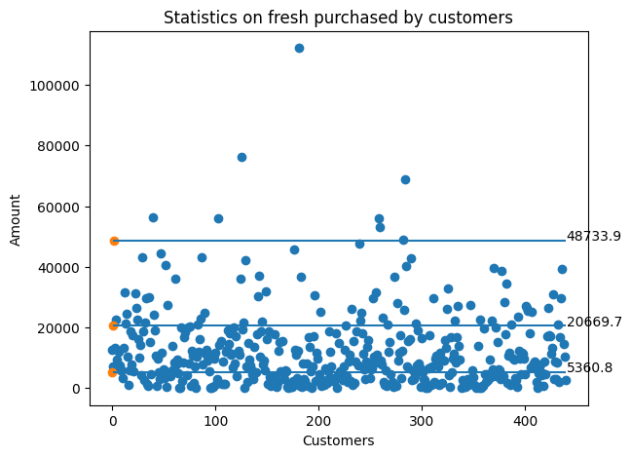
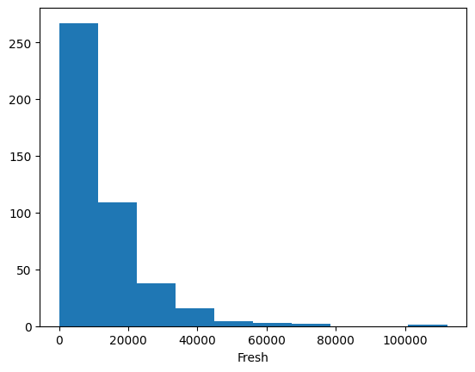
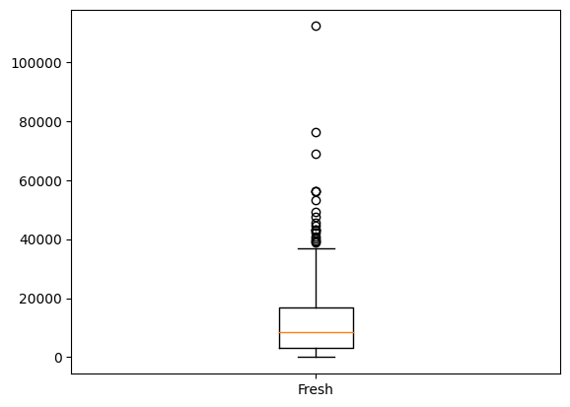
Unsupervised Learning
Input data without label
E.g. Big Customer?
A customer account wants to get more discounts because he claims to be a major customer of the company, and the total amount of fresh food purchased is 30K+.
Data will tell us. (segment customer by K-Means)
Sorry, the answer is “No”.
More Statistics Approaches

Slide 6

Determine the Similarity or Dissimilarity
Though the objective of K-Means is to form clusters in such a way that similar samples go into a cluster, and dissimilar samples fall into different clusters, it can be shown that instead of a similarity metric, we can use dissimilarity metrics.
In other words, conventionally the distance of samples from each other is used to shape the clusters.
Dissimilarity metrics
Euclidean distance
Manhattan distance
Cosine similarity
Jaccard distance
Intra-cluster distances are minimized
Dis(x5, x6)
Dis(x1, x2)
Inter-cluster distances are maximized
Dis(C2, C3)
$$Dis\left(x_{1}, x_{2}\right)= \sum_{i=0}^{n}{{(x_{1i} − x_{2i})}^{2}}$$

Slide 7
Curse of Dimensionality
Now dimensionality refers to the number of features in our data. Theoretically and in ideal situations, the more features we have, the better the model should perform since models have more things to learn from, so they should therefore be more successful. However, real life is more complicated than that. There are several reasons why too many features may end up leading to worse performance in practice.
Dimensionality Reduction
PCA (Principal Component Analysis)
…

Slide 8

K-Means Algorithms
Initialize K = 3 centroids randomly
Distance calculation
Assign each point to the closest centroid
Compute the new centroids for each cluster
Repeat until there is no more changes
Iterative algorithm
Heuristic algorithm
no guarantee that it will converge to the global optimum
$$SSE= \sum_{1}^{n}{{(x_{i} − C_{j})}^{2}}$$
SSE = the sum of the squared differences between each points and its centroids

Slide 9
K-Means Accuracy
External approach
Compare the clusters with the ground truth, if there is available.
Internal approach
Inertia
Sum of squared distances of samples to their closest cluster center.
Distortion
Average the distance between data points within a cluster.
Silhouette Coefficient
The mean intra-cluster distance (a) and the mean nearest-cluster distance (b) for each sample.
Choosing K.
Elbow Method
Metric
Elbow Point
K

Slide 10
Practical Example
Database
Wholesale customers data.csv (UCI Machine Learning Repository)
The data set refers to clients of a wholesale distributor. It includes the annual spending in monetary units (m.u.) on diverse product categories.
Attribute Information: 1) FRESH: annual spending (m.u.) on fresh products (Continuous); 2) MILK: annual spending (m.u.) on milk products (Continuous); 3) GROCERY: annual spending (m.u.)on grocery products (Continuous); 4) FROZEN: annual spending (m.u.)on frozen products (Continuous) 5) DETERGENTS_PAPER: annual spending (m.u.) on detergents and paper products (Continuous) 6) DELICATESSEN: annual spending (m.u.)on and delicatessen products (Continuous); 7) CHANNEL: customersâ€™ Channel - Horeca (Hotel/Restaurant/CafÃ©) or Retail channel (Nominal) 8) REGION: customersâ€™ Region â€“ Lisnon, Oporto or Other (Nominal)
Goal
Group customer for better service.

Slide 11
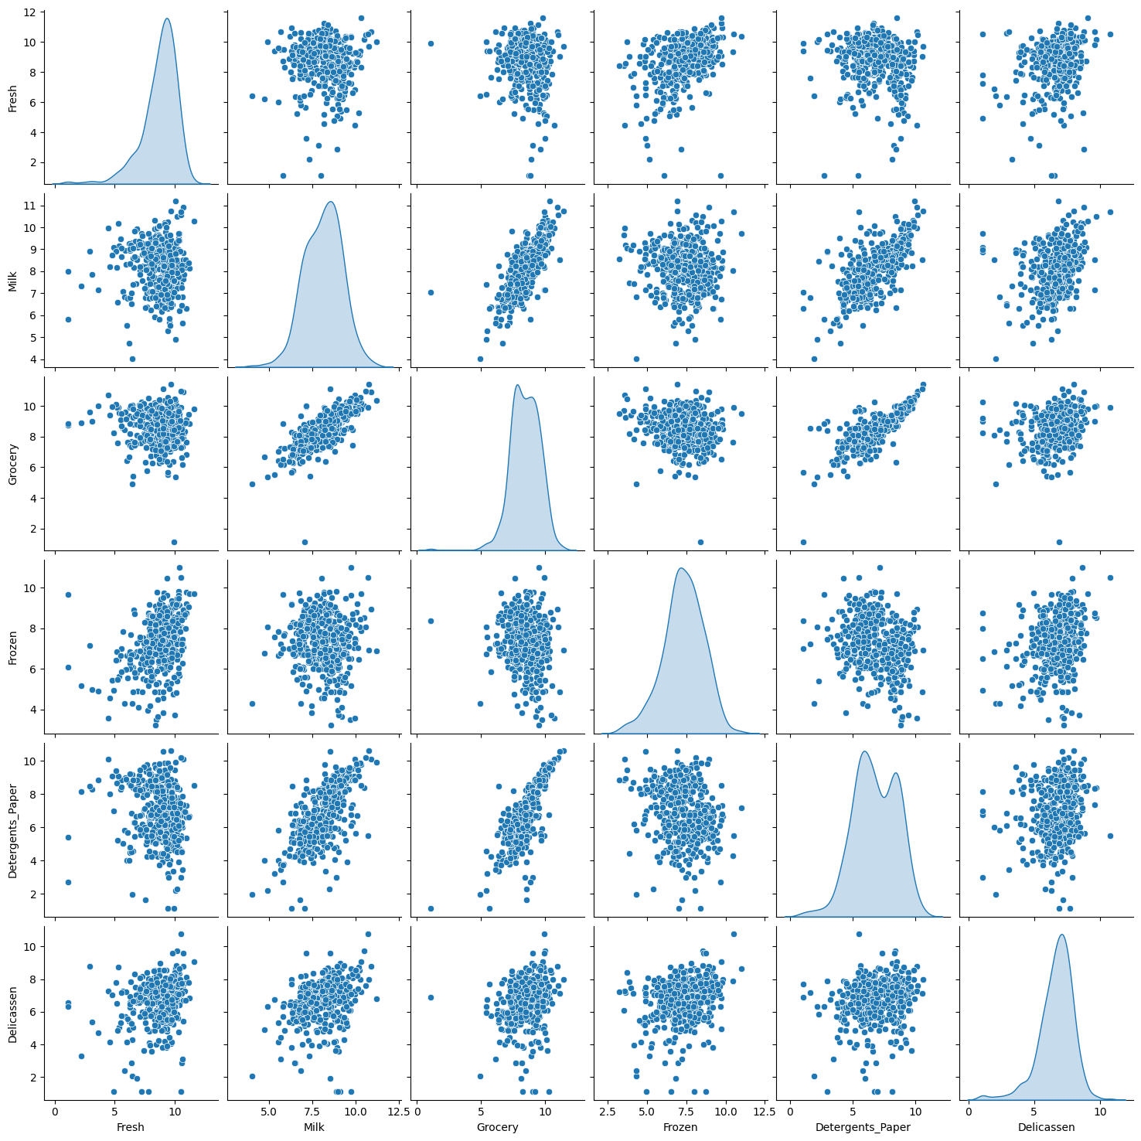
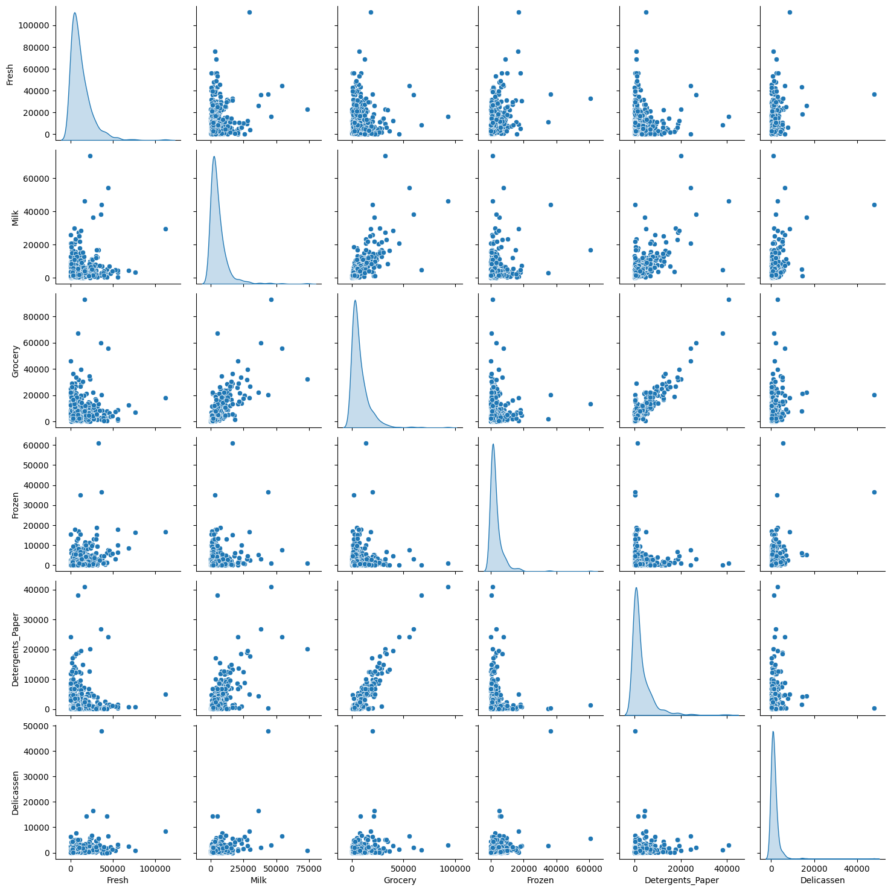
Data Preparation
Focus on wholesale product
Remove attribute “Channel”, “Region”
Make the data distribution appear normal
Many approaches are good at normally distributed data
Take log function
Make huge numbers smaller
Find relationship between Milk and Grocery

Slide 12
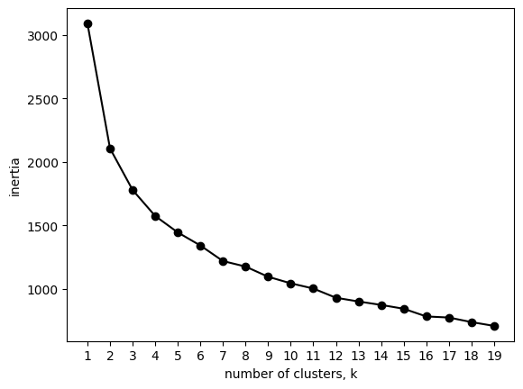
Find the “elbow” point
Take K = 6
Elbow Point

Slide 13
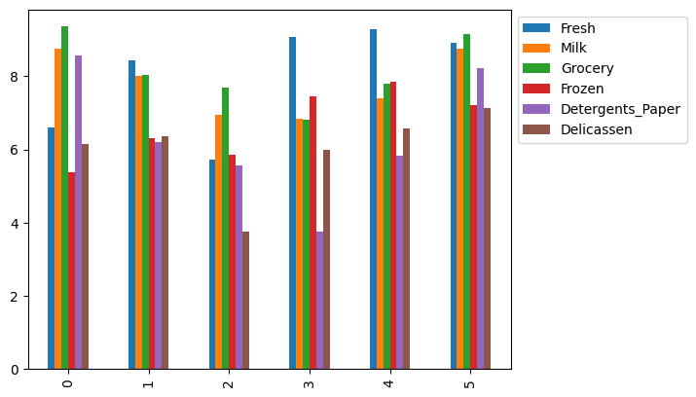
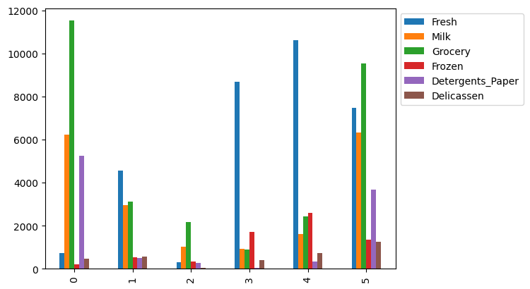
Group Customer
Customer A: likes both Milk and Grocery (supported by all clusters 0 – 5)
Customer B: like Fresh very much but dislike Detergents Paper (cluster 3, 4)

Slide 14
Links
Wholesale customers Data Set
sklearn.cluster.Kmeans
matplotlib.pyplot.scatter
seaborn.pairplot
Jupyter Notebook & Python Code for this presentation

Slide 15
Section title

Slide 16


You can personalize this
last page with a short link
(ex. www.st.com/shortlink)
You can find a complete list of st.com short links on this page:
http://seo.st.com/toolbox/shortcuts/
Find out more at www.st.com

Slide 17

Please remove this page
before publishing the
presentation
For further support in creating a PowerPoint presentation, including graphic assets, formatting tools and additional information on the ST brand
you can visit the ST Brand Portal https://brandportal.st.com

